Slide 1

Yellow Change Interval Physics In Opposition
Autonomous Vehicles Symposium, Stuttgart, 6/2/2016
Brian Ceccarelli, P.E.
President

Slide 2
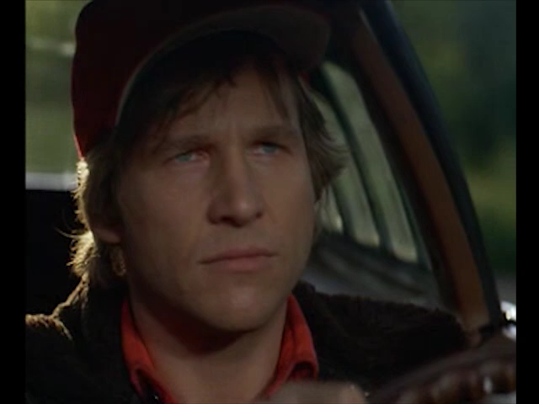
“Red light stop. Green light go. Yellow light go very fast.”

Slide 3
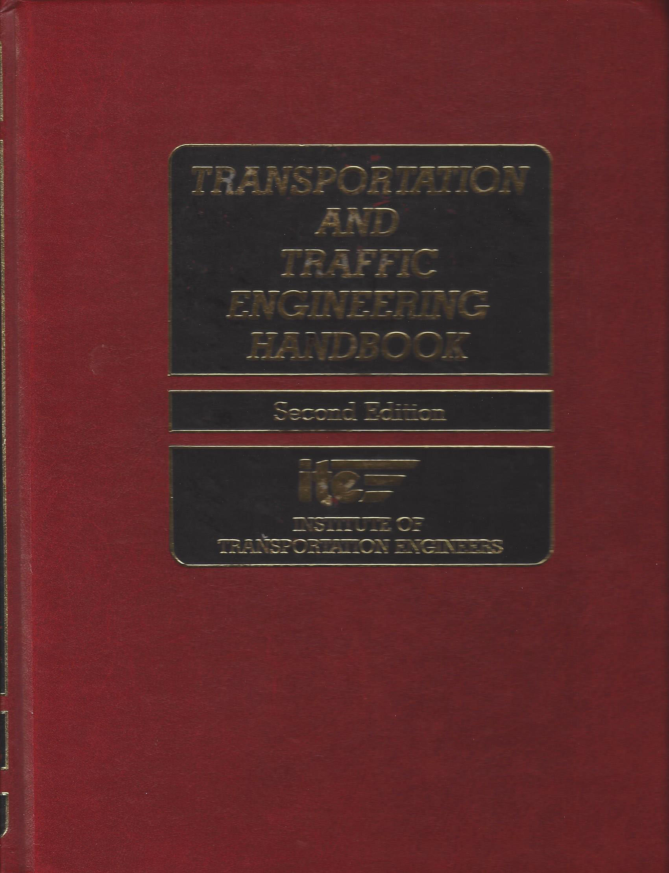
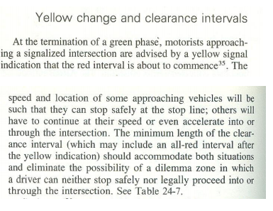

Slide 4
Our testing problems with the yellow light are caused by traffic engineering failures.
We cannot overcome these failures. The failures are rooted in physics, not in human or artificial intelligence (AI) factors.
We will not be able to deliver vehicles to market. We must first confront the Institute of Transportation Engineers (ITE).

Slide 5
Assigning Blame -- Presumption
We presume and blame drivers for red light running and crashes. So does the Law. We are ignorant of the misapplied physics within the engineering.
Ramifications for Vehicle Manufacturers
FHWA introduced legislation. AI will be the legal driver. Vehicle manufacturers are now liable for paying red light camera penalties exceeding USD $ 1,000,000,000.00 / year.
Notes:
Human drivers are being held culpable for these traffic engineering failures now.
When all vehicles on the road are self-driving, the manufacturers will be held culpable for all infractions and will not be able to blame a human driver.
I have notified all the authorities in the matter. ITE has chosen to conceal its mistakes. The vast majority of traffic engineers do not understand physics.

Slide 6
Autonomous Vehicle Manufacturers
---------------------------------------------
Design Requirements with Priorities
Safe Motion of Traffic
Legal Motion of Traffic
Efficient Motion of Traffic
Assumes Capable AI

Slide 7
Traffic Engineers
----------------------------------------------
Design Priorities
Efficient Motion of Traffic
Safe Motion of Traffic
3.Legal Motion of Traffic
Notes:
Now lets get down to the physics.

Slide 8
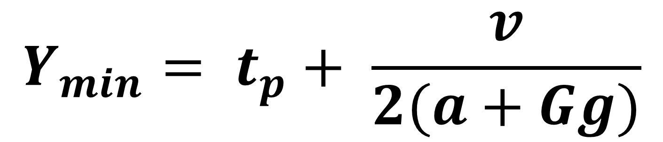
Yellow Change Interval Equation
$$Y_{min}= t_{p}+ \frac{v}{2(a+Gg)}$$
Y = yellow change interval
t_{p} = perception-reaction time, typically 1.0 s
a = deceleration, typically 10 ft/s/s (3.0 m/s²)
G = grade
g = Earth’s gravitation acceleration 32 ft/s/s (9.8 m/s²)
Notes:
This is the ITE yellow change interval equation. g is gravitation acceleration and G is grade.

Slide 9
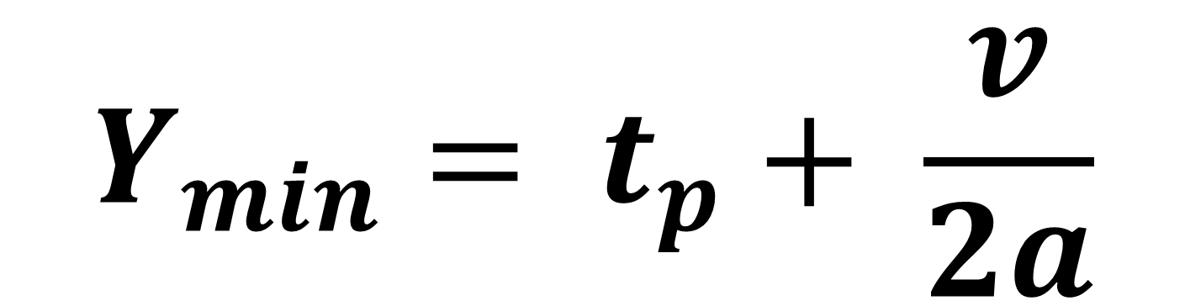
$$Y_{min}= t_{p}+ \frac{v}{2a}$$
Notes:
Anybody see the problem?
The 2 is the problem. The 2 makes the yellow change interval half the time it takes a vehicle to stop. The “2” is the sole creator of the dilemma zone. It is what forces a driver to decide between stop and go-full-speed.

Slide 10
$$Y_{min}= t_{p}+ \frac{v}{2a}$$
Notes:
The 2 is the problem. The 2 makes the yellow change interval half the time it takes a vehicle to stop. The “2” is the sole creator of the dilemma zone. It is what forces a driver to decide between stop and go-full-speed.

Slide 11
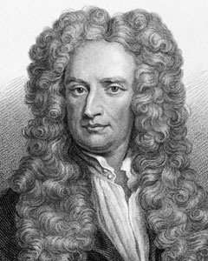

$$t=\frac{v_{0}}{a}$$
Notes:
From Newton’s Laws of Motion, the time to stop = the initial velocity divided by deceleration. There is no “2”.

Slide 12
5 Errors and Omissions
The causes of red light running . . .
Misapplication of a Math Equation
Misapplication of Stochastic Methods to Input Variables
Ambiguity of Approach Speed
Misapplication of an Analytic Solution for Grade
Omission of Tolerances
Notes:
I will only have time to describe 1. I will touch on 2 and 3. 4 and 5, as well as the rest, can be found in “Yellow Change and Red Clearance Solution.”

Slide 13
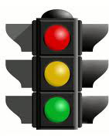
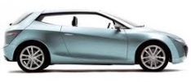
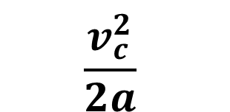


Critical Point
Comfortable Stopping Distance
Braking Point
End of Perception-Reaction Time
C
B
E
Must Stop
Must Go
$$\frac{v_{c}^{2}}{2a}$$
$$v_{c}t_{p}$$
$$c$$
Notes:
Where does the ITE formula come from? It is the distance travelled during the PR time + the braking distance.

Slide 14
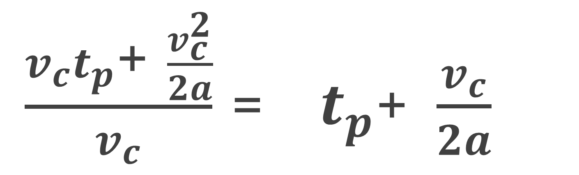
Yellow Change Interval equals the Critical Distance Divided By Average Speed Traversing the Critical Distance
$\frac{v_{c}t_{p}\text{+ }\frac{v_{c}^{2}}{2a}}{v_{c}}$ = $t_{p}\text{+ }\frac{v_{c}}{2a}$
Notes:
Equation assumes the driver traverses the critical distance at constant speed Vc which is the maximum allowable speed.

Slide 15
ITE Yellow Change Interval Equation
works only for
UNIMPEDED THROUGH-MOVEMENTS
Notes:
Gazis, Herman and Maradudin designed the formula only to work for one specific type of traffic motion. Cars going straight who never slow down from the speed limit.

Slide 16
ITE Formula Preconditions
Driver must go the maximum allowable speed or faster from the critical point to the intersection entry point.
After crossing the critical point, the driver must not slow down.
Driver must know exact location of critical point.
Driver must react faster than the input perception-reaction time and decelerate more quickly than the deceleration constant.
Notes:
The ITE formula is very limited in its use.

Slide 17

ITE Yellow Change Interval Equation
Shorts the Yellow Light, Creating Type 1 Dilemma Zones for
Turning Movements
Impeded Movements
Notes:
The ITE formula does not work for turns. It is does not work for straight-thru traffic when there are nearby businesses or side-streets from which cars emerge or egress. The formula does not work for any slowing down maneuver, not even to avoid a pedestrian. Hence drivers in order to avoid running a red light, throw caution to the wind. The formula only supports a driver going as fast as he can. This is also the reason why drivers beat the light.

Slide 18
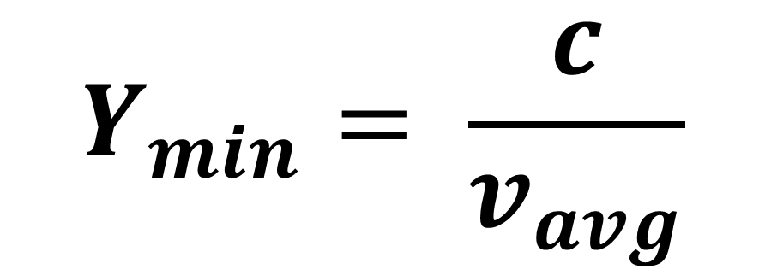
General Form of the Correct
Yellow Change Interval Equation
$$Y_{min}= \frac{c}{v_{avg}}$$
Notes:
C is the critical distance, or comfortable stopping distance. Once you cannot stop, the time it takes for you reach the intersection is that distance divided by your average speed.

Slide 19


Left and Right Turns:
$$Y_{min}= \frac{c}{(v_{c}+ v_{e})/2}$$
U-Turn and Avoidance Movements:
$$Y_{min}= t_{p}+ \frac{v_{c}}{a}$$
Notes:
This is the proper application of physics for a turning lane yellow. Note that the yellow must be longer, not shorter, than a straight through lane yellow.

Slide 20
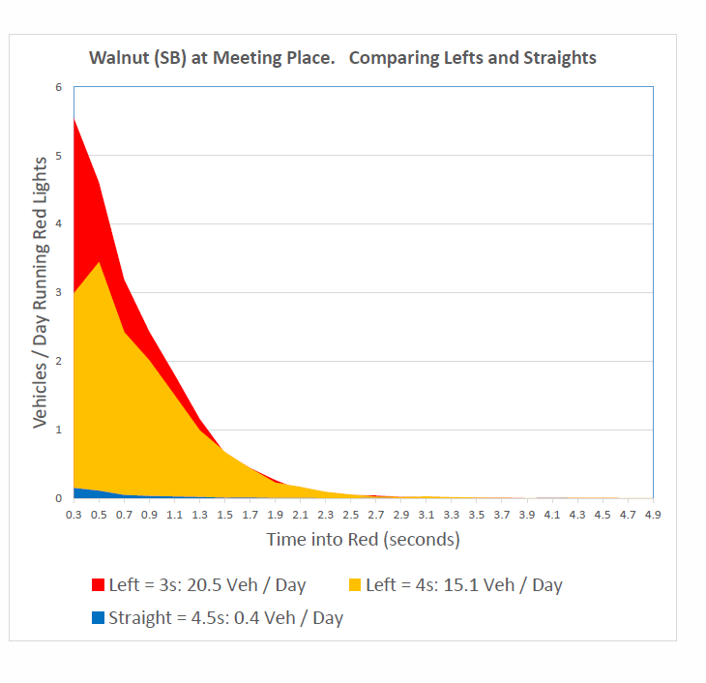
> 90%
Notes:
Over 90% of all red light running is caused by underlying physics problem with the yellow change interval equation.
Red and yellow curves are for the turn lanes.
Blue is for the through lanes.
The curves are not random distributions.
The curves follow the laws of physics whose x-intercept is the stopping time.
Uniform distributions form after the stopping time = 7.4 seconds – (yellow change interval)

Slide 21
Other Traffic Engineering Errors
  Invalid Measurement Locations for v_{c} and G
    V measured at stop bar
    V measured inside intersection
    V is less than speed limit
  Stochastic Solutions
    Imagine bridge engineer designing bridge to sustain only the average weight passenger car.
    t_{p} is for average passenger car driver at simplest intersection on dry pavement
    Deceleration is for average passenger car
Notes:
Do not use stochastic methods to determine PR time or deceleration. Stochastic methods apply only to non-random events. Just as a bridge engineer cannot design a bridge to sustain only the average weight vehicle, you cannot set a yellow interval according to the average person’s PR time and average passenger car’s deceleration.

Slide 22
Analytic not Physical Solution
  The grade G in term “gG” comes from an emergency braking distance formula. It is an analytic solution which does not apply to non-emergency “expected” events such as yellow lights.
4. Omission of Tolerances
  No propagation of errors. Law enforcement presumes calculated value is exact.
  Y = 4.5 seconds (ITE calculation)
    Y = 5.4 seconds +/- 2.3 seconds (True to physics)
Notes:
All branches of engineering use tolerances. Via the technique of error propagation, one can compute the error in the yellow change interval. For a 45 mph road, the fully qualified yellow interval is 4.3 +/- 2.3 seconds. Set the RLC delay (grace period) to 2.3 seconds.
Do not apply analytic solutions unless they have a physics reality. The gG term in the full ITE formula comes from the emergency braking SSD equation for the case when maximum frictional force applies between road and tire. This is not the case of a normal approach to a signalized intersection. gG applies downhill, but does not apply uphill.

Slide 23


Call:
Douglas E. Noble, P.E., PTOE
Senior Director
Management and Operations
Institute of Transportation Engineers
1627 I (“Eye”) Street, NW
Suite 600
Washington, DC 20006
PH: +1 (202) 785-0060, x 148
FAX: +1 (202) 785-0609
dnoble@ite.org

Slide 24


