Slide 1
Physics of the Yellow Change Interval
ITE International Convention, 8/3/2015

Slide 2
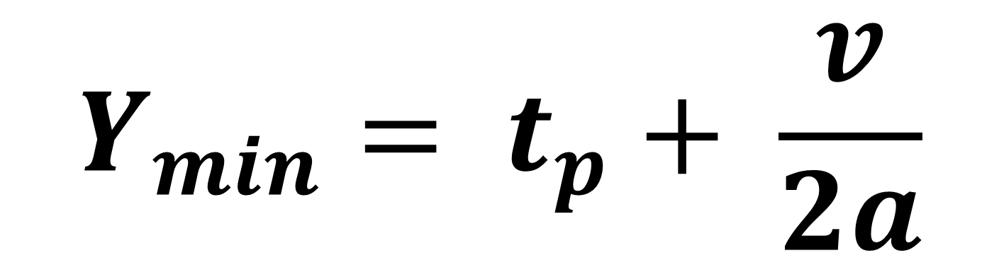
$$Y_{min}= t_{p}+ \frac{v}{2a}$$
Notes:
This is the ITE yellow change interval equation. Assume grade = 0.

Slide 3
$$Y_{min}= t_{p}+ \frac{v}{2a}$$
Notes:
The 2 is the problem. The 2 makes the yellow change interval half the time it takes a vehicle to stop. The “2” is the sole creator of the dilemma zone. It is what forces a driver to decide between stop and go-full-speed. It is the reason why drivers beat the light or slam on the brakes.

Slide 4

$$t=\frac{v_{0}}{a}$$
Notes:
From Newton’s Laws of Motion, the time to stop = the initial velocity divided by deceleration. There is no “2”.

Slide 5
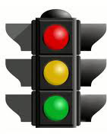
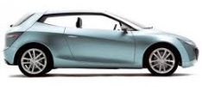
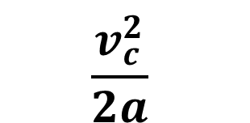


Critical Point,
Comfortable Stopping Distance,
Braking Point
End of Perception-Reaction Time
C
B
E
Must Stop
Must Go
$$\frac{v_{c}^{2}}{2a}$$
$$v_{c}t_{p}$$
$$c$$
Notes:
Where does the ITE formula come from? It is the distance travelled during the PR time + the braking distance.

Slide 6

For the ITE yellow change interval formula to work, how fast must you go to make it to the intersection before the light turns red?
$$\frac{Distance}{Speed} = Time$$
$\frac{v_{c}t_{p}\text{+ }\frac{v_{c}^{2}}{2a}}{v_{c}}$ = $t_{p}\text{+ }\frac{v_{c}}{2a}$
Notes:
Dividing the stopping distance by your initial speed before you begin braking, yields the ITE yellow change interval.
You must never fall under the maximum allowable speed.

Slide 7
For the ITE yellow change interval formula to work . . .
You must go the maximum allowable speed or faster from the critical point to the intersection entry point.
Slowing down is forbidden.
Which is the reason why people beat the light.
You must know exactly where the critical point is.
Notes:
The ITE formula has a very restricted use.

Slide 8
ITE Yellow Change Interval Equation
works only for
UNIMPEDED THROUGH-MOVEMENTS
Notes:
Gazis, Herman and Maradudin designed the formula to work only for one specific type of traffic motion: cars going straight that never slow down below the speed limit.
For all other vehicle movements, the formula calculates a yellow light that is too short. The formula creates a type I dilemma zone. A type I dilemma is a no-win scenario: there is neither the distance for you to stop nor the time for you to reach the intersection before the light turns red.

Slide 9
ITE Yellow Change Interval Equation
SHORTS THE YELLOW for
UNIMPEDED TURNING-MOVEMENTS
IMPEDED MOVEMENTS
Notes:
The ITE formula does not work for turns. It is does not work for straight-thru traffic when there are nearby businesses or side-streets from which cars emerge or egress. The formula does not work for any slowing down maneuver, not even to avoid a pedestrian. Hence drivers, in order to avoid running a red light, throw caution to the wind. The formula only supports a driver going as fast as he can.

Slide 10
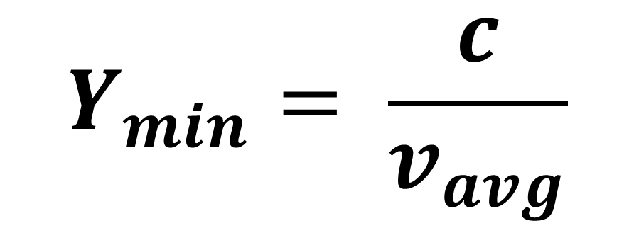
General Form of a “Standard”
Yellow Change Interval Equation
$$Y_{min}= \frac{c}{v_{avg}}$$
Notes:
C is the critical distance, or comfortable stopping distance. Once you cannot stop, the yellow time must be at least the time it takes for you to traverse that stopping distance. It is the stopping distance divided by your average speed.

Slide 11
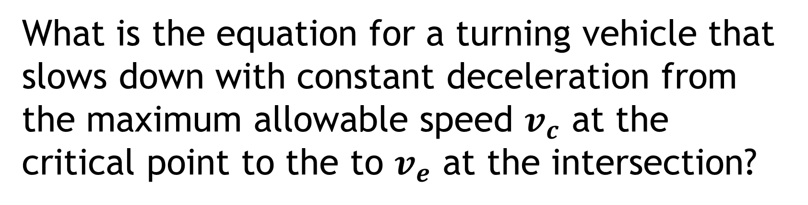
What is the equation for a turning vehicle that slows down with constant deceleration from the maximum allowable speed $v_{c}$ at the critical point to the to $v_{e}$ at the intersection?

Slide 12

What is the equation for a turning vehicle that slows down with constant deceleration from the maximum allowable speed $v_{c}$ at the critical point to the to $v_{e}$ at the intersection?
$$Y_{min}= \frac{c}{(v_{c}+ v_{e})/2}$$
Notes:
This is the proper application of physics for a turning lane yellow. Note that the yellow must be longer, not shorter, than a straight through lane yellow.

Slide 13

What is the equation for impeded movements and U-turns?
$$Y_{min}= t_{p}+ \frac{v_{c}}{a}$$
Notes:
This is the only possible solution to handle all allowable traffic movements. It is the one-size-fits-all equation. It is directly from Isaac Newton himself. Upon seeing a light turn yellow, a driver will always know that if he decelerates comfortably as if stopping, he will never run a red light. He also has the time to slow down to turn or slow down to avoid a potential hazard in front of him.

Slide 14
What else should ITE take from the physics tool box?
Engineering Tolerances for purposes of law enforcement
Acceptance of only Physical Solutions. Only physical solutions are engineering practices.
  Not Stochastic Solutions
  Not Analytic Solutions
  Not Misapplications of Physics
Notes:
All branches of engineering use tolerances. “time”, like dimensions of width or length, also has a tolerance. Via the technique of error propagation, one can compute the error in the yellow change interval. For a 45 mph road, the fully-qualified yellow interval is 4.3 +/- 2.3 seconds. Set the RLC delay (grace period) to 2.3 seconds.
Do not apply analytic solutions unless they have a physical reality. The gG term in the full ITE formula comes from the emergency braking SSD equation for the case when maximum frictional force applies between road and tire. gG works for emergency braking conditions but does not apply to normal approaches to intersections. gG applies downhill, but does not apply uphill.
Do not use stochastic (statistical) methods to determine PR time or deceleration. Stochastic methods apply only to non-random events, not predictable events such a PR times and decelerations. Just as a bridge engineer cannot design a bridge to sustain only the “average” weight vehicle, neither can you set a yellow interval according to the “average” person’s PR time and “average” passenger car’s deceleration.

