Slide 1
Signalized Intersections Prevent Travelling from Point A to B Legally
Brian Ceccarelli, P.E., Principal Engineer
Autonomous Vehicles Symposium, Michigan, October 25, 2017

Slide 2
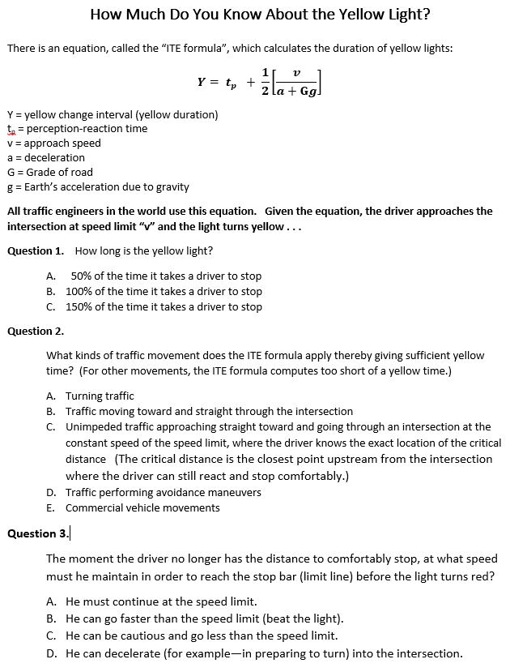

Slide 3
Question | Answer | Question | Answer
1 | A | 6 | D
2 | C | 7 | The 2 comes from the distance equation: d = v²/2a. Where v is the velocity of the car at this distance where it starts decelerating at constant “a”.
3 | A and B | 8 | If the driver is farther from the intersection than the critical distance, then the driver has the distance to stop. He must stop. If the driver is closer to the intersection than the critical distance, he must proceed at the speed limit “v” or more toward and into the intersection.
4 | A | 9 | False
5 | B | 10 | C

Slide 4
Requirements
Can a manufacturer develop an AV which passes validation?
1. The AV shall travel safely.
2. The AV shall travel legally.
3. The AV shall travel efficiently.
4. The AV shall travel comfortably.
Notes:
Can a manufacturer actually develop a car which meets the requirements?
Safely: Do not drive off a cliff. Do not run into pedestrians. Do not rear-end vehicles.
Legally: Do not cross the double yellow line. Do not drive on the shoulder. Stop before the stop-line at a red light. Stop at a red light.
Efficiently: Do not travel 10 mph on the interstate.
Comfortably: Do not use regenerative braking. Do not slam on the brakes for a yellow light.

Slide 5
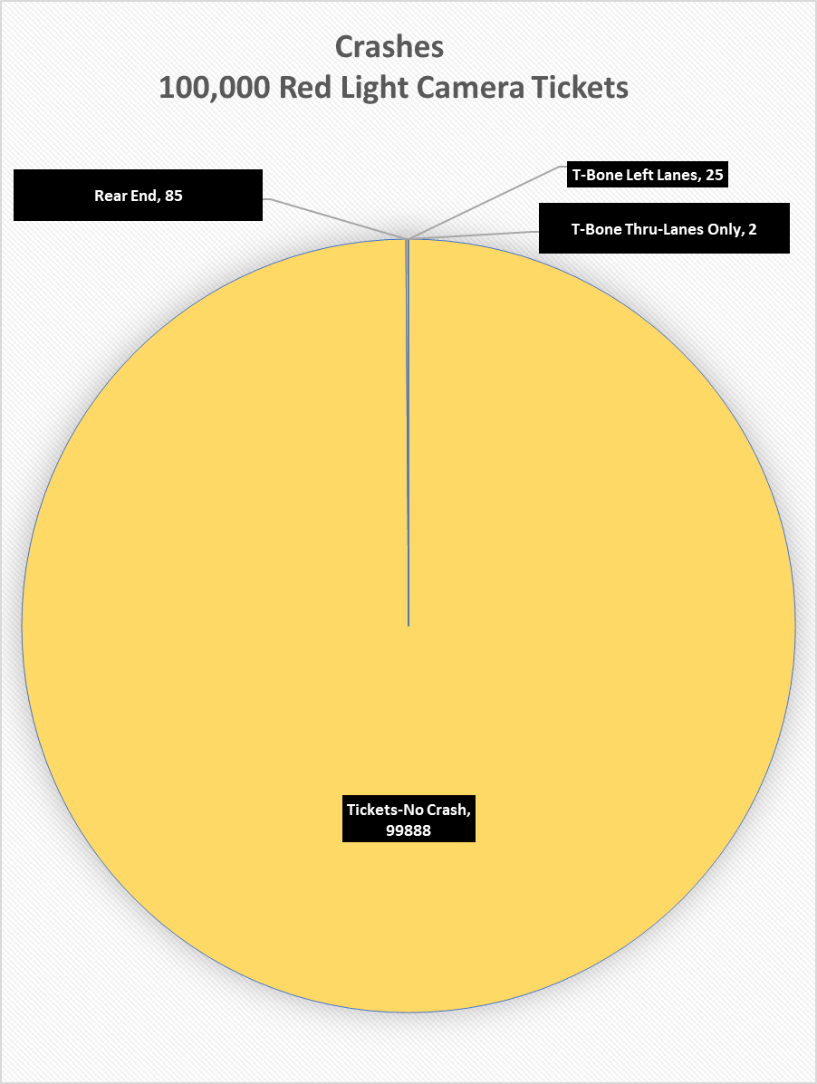
Suffolk County, New York
Red Light Camera Safety Report - 2015

Slide 6
Assumptions
Traffic engineers have designed signalized intersections so that a vehicle can always travel safely.
Traffic engineers have designed signalized intersections so that a vehicle can always travel legally.
Notes:
Limit our focus to just signalized intersections. The design engineers assumes these things.

Slide 7
Notes:
Illustrate the difference between safely and legally. From the movie “Starman”, 1984, Jeff Bridges plays the part of an alien visiting Earth. Did Jeff drive legally? Did Jeff drive safely?

Slide 8
Notes:
A real-life RLC clip from Long Island, New York. May 2017. Did the sedan driver drive safely? Did the sedan driver drive legally? Did the sedan driver drive comfortably? Did the commercial truck drive safely? Legally? Comfortably? The yellow light neither gives a commercial vehicle the distance to stop nor the time to reach the intersection before the light turns red.

Slide 9
Notes:
A real-life RLC clip from Knightdale, North Carolina. Same questions: Did the sedan driver drive safely? Legally? Comfortably? But about the bus driver? Note that the sedan had just arrived at the intersection as the light turns red. In order for this to happen, the sedan had to slam on his brakes. Note the sedan is not parallel to the lane.

Slide 10
Notes:
199,999 of 200,000 red light camera clips look like this. 50% of drivers run red lights within a blink of an eye—imperceptible to the human eye. 70% run the light within fraction of a second. Are the drivers driving safely? Are the drivers driving comfortably? The last driver got a ticket. Did he drive legally? The yellow failure causes drivers enter the intersection up to 4 seconds into the red.

Slide 11
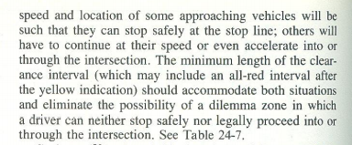
Institute of Transportation Engineers,
Transportation and Traffic Engineering Handbook, 1982

Slide 12
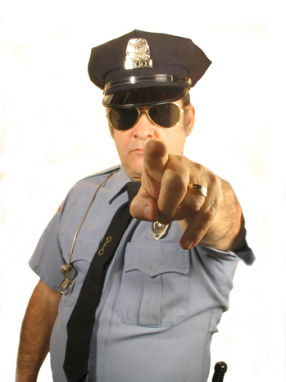
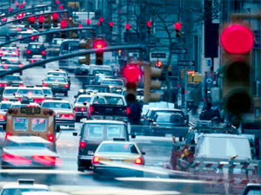
Notes:
As the developer of the AI and/or the deterministic systems, which one do you want the occupants of the vehicle to avoid?

Slide 13
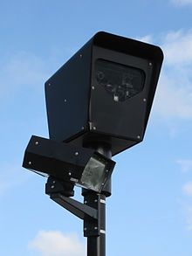
Govt/RLC industry will punish AV manufacturers > $2 billion each year for systematic defects introduced by traffic engineers.
Notes:
What do you want to avoid now?

Slide 14
AV Manufacturers’ Priorities
1
2
3
Notes:
The apparent priorities in the requirements for AVs. Do AV manufacturers have priorities or do they expect to satisfy all goals at the same time?

Slide 15
Traffic Engineers’ Priorities
TxDOT Report 0-4372-2
1
2
8
Notes:
Lei Yu, the author of TxDOT Report -04372-2, timed the yellow according to the votes of the traffic engineering community. Instead of using engineering practice to determine yellows, he used democracy and twisted the math to conform to the vote. Yu twisted math is the misapplication of stochastic methods. Yu is coauthor to Chiu Lu’s paper, a paper which was published earlier which places the legal motion of traffic as first priority. Yu’s conclusions in his follow-up paper contradict his first paper. Yu establishes yellow times by vote, knowingly forcing drivers to run red lights.

Slide 16
The Yellow Change Interval Equation
1959

Slide 17
Yellow Change Interval Definition
Requirements:
Shall provide the distance to comfortably stop.
Shall be the amount of time the driver needs to reach and enter the intersection when he cannot comfortably stop.

Slide 18
$$Y= t_{p}+ \frac{v}{2(a+gG)}$$
Y = yellow change interval
t_{p} = perception-reaction time
v = approach speed
a = deceleration
g = Earth’s gravitational acceleration
G = Grade of road (slope y/x where + is uphill)
Notes:
This is the ITE yellow change interval equation as it appears in ITE’s Determining Vehicle Change Intervals, 1985.
Anyone see the problem with this equation? It takes a physicist about 20 seconds to spot the problem.
This form as the gG from Parsonson and Santiago.
Note that the equation is an equality. Note the subscript v-naught for velocity. The subscript indicates initial velocity before the vehicle begins decelerating.

Slide 19
The equation works only for unimpeded straight-through movements given that driver and vehicle meet preconditions for t_{p} and a.
Notes:
The ITE formula is very limited in its use.

Slide 20
Errors and Omissions
Wrong algebra (Equation is special case but applied universally.)
Wrong value for approach speed (misunderstanding of physics)
Wrong value for perception-reaction time (misapplied stochastic method)
Wrong value for deceleration rate (misapplied stochastic method)
Term gG wrong half the time. (gG is an analytic solution, not a physical solution.)
Omission of tolerances (Drivers are punished for the error (uncertainty) in the yellow change interval calculation.
Notes:
This is the proper application of physics for a turning lane yellow. Note that the yellow must be longer, not shorter, than a straight through lane yellow.

Slide 21
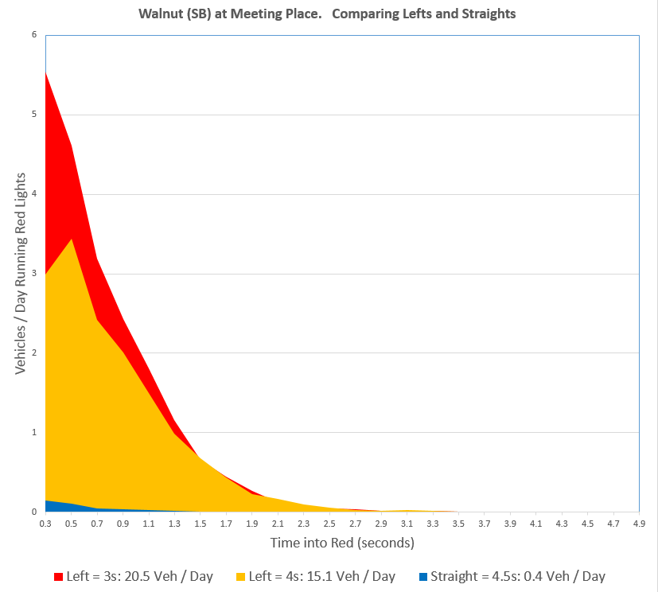

Slide 22
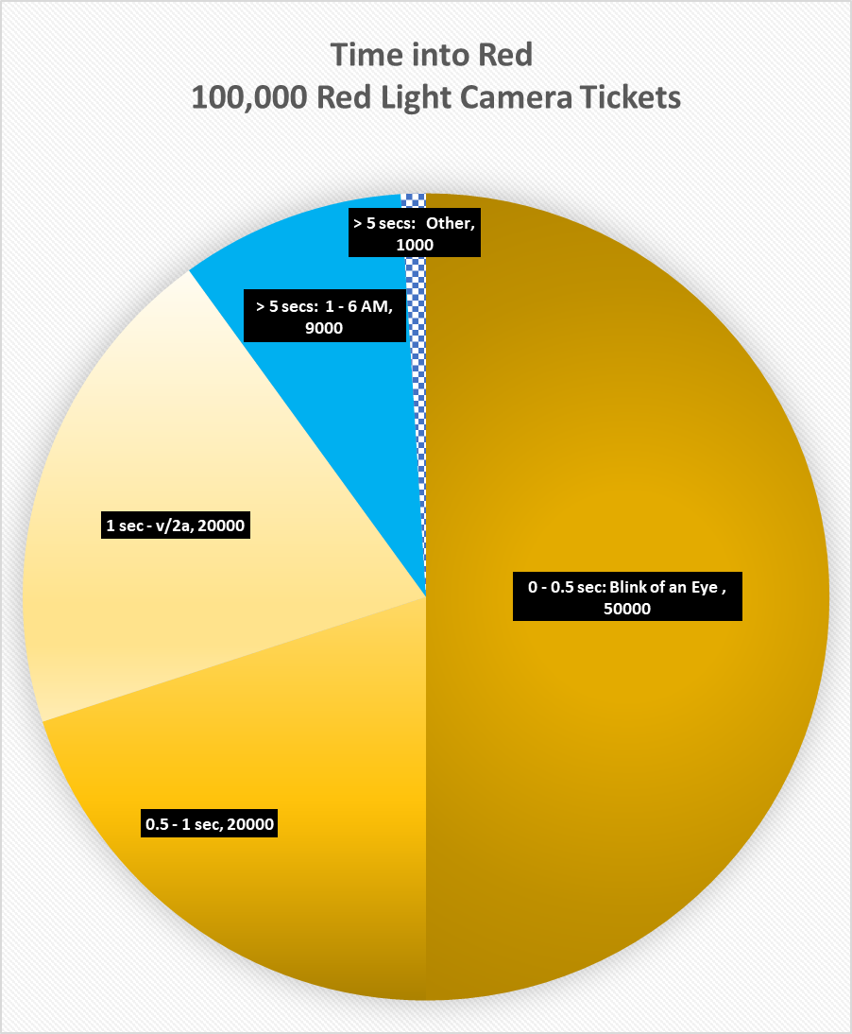
The misapplication of physics in the calculation of the yellow light duration is responsible for about 90% of all tickets and crashes.
Cary, North Carolina
Red Light Camera Data
2004 - 2012

Slide 23
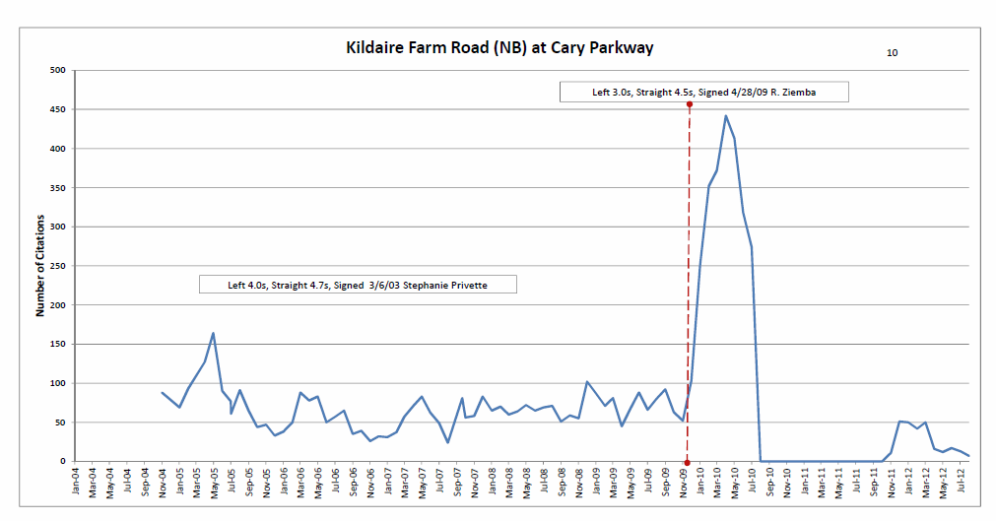
Notes:
Cary, NC

Slide 24
Financial Problem
When the AI drives as manufacturer prescribes, manufacturers are legally culpable for consequences. Manufacturers will be punished with a $2 billion bill annually for systematic errors created by traffic engineers.
Legal
The traffic engineer, not the DOT or the City, is legally responsible for the injuries, both financial and physical, at intersections he designs. He is responsible to safeguard the life, health and property of the public by applying the physical and mathematical sciences to his designs.
The traffic engineer violates 23 CFR 655 part F, MUTCD 4D.26 (3).
Notes:
Government and red light camera companies exploit the errors and omissions for profit. This is called racketeering.
Traffic engineers will not acknowledges these errors and omissions for fear their careers and reputations will be destroyed.
ITE started the problem in 1965 when it miscopied the yellow change interval equation into its 3rd Edition of the Traffic Engineering Handbook.
IIHS and its various member organizations, like AAA, profit from the cameras by raising insurance premiums based on red light running.

Slide 25
http://talussoftware.com
http://redlightrobber.com
Brian Ceccarelli, P.E., Principal Engineer
Autonomous Vehicles Symposium, Michigan, October 25, 2017

Slide 26
Analysis of the Equation
Brian Ceccarelli, P.E., Principal Engineer
Autonomous Vehicles Symposium, Michigan, October 25, 2017

Slide 27
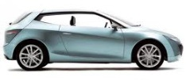
Critical Point,
Comfortable Stopping Distance,
Braking Point
End of Perception-Reaction Time
C
B
E
Must Stop
Must Go
$$\frac{v_{c}^{2}}{2a}$$
$$v_{c}t_{p}$$
$$c$$
Notes:
Where does the ITE formula come from? It is the distance travelled during the PR time + the braking distance.

Slide 28
$$Y_{min}= \frac{c}{v_{avg}}=$$
= $\frac{v_{c}t_{p}\text{+ }\frac{v_{c}^{2}}{2a}}{v_{c}}$ = $t_{p}\text{+ }\frac{v_{c}}{2a}$
Notes:
From Newton’s Laws of Motion, the time to stop = the initial velocity divided by deceleration. There is no “2”.

Slide 29
$$Y= t_{p}+ \frac{v}{2(a+gG)}$$
#1. Error. Wrong Algebra
Traffic engineers apply this algebra to all traffic movements.
BUT:
The equation works for only a special case.
Notes:
This is the ITE yellow change interval equation as it appears in ITE’s Determining Vehicle Change Intervals, 1985. This form as the gG from Parsonson and Santiago.
Note that the equation is an equality. Note the subscript v-naught for velocity. The subscript indicates initial velocity before the vehicle begins decelerating.

Slide 30
$$Y= t_{p}+ \frac{v}{2(a+gG)}$$
#2. Error. V measured at wrong location
Some DOTs measure v inside the intersection. For turning lanes, some compute it as half the speed limit and intersection speed.
BUT:
V must be measured at the critical distance upstream from the intersection.
Notes:
This is the ITE yellow change interval equation as it appears in ITE’s Determining Vehicle Change Intervals, 1985. This form as the gG from Parsonson and Santiago.
Note that the equation is an equality. Note the subscript v-naught for velocity. The subscript indicates initial velocity before the vehicle begins decelerating.

Slide 31
$$Y= t_{p}+ \frac{v}{2(a+gG)}$$
#3, 4. Error. Traffic engineer misapply stochastic methods by calculating singular values, those being average values) for human perception-reaction time and vehicle deceleration
BUT:
“Average” vs “Allowable”. Perception-reaction time and deceleration are each ranges of valid values representing normal behavior. If a bridge engineer designed bridges like traffic engineers set yellows, then the bridge would only uphold the weight of the average passenger sedan, and yet allow school buses to go over it.
Notes:
This is the ITE yellow change interval equation as it appears in ITE’s Determining Vehicle Change Intervals, 1985. This form as the gG from Parsonson and Santiago.
Note that the equation is an equality. Note the subscript v-naught for velocity. The subscript indicates initial velocity before the vehicle begins decelerating.

Slide 32
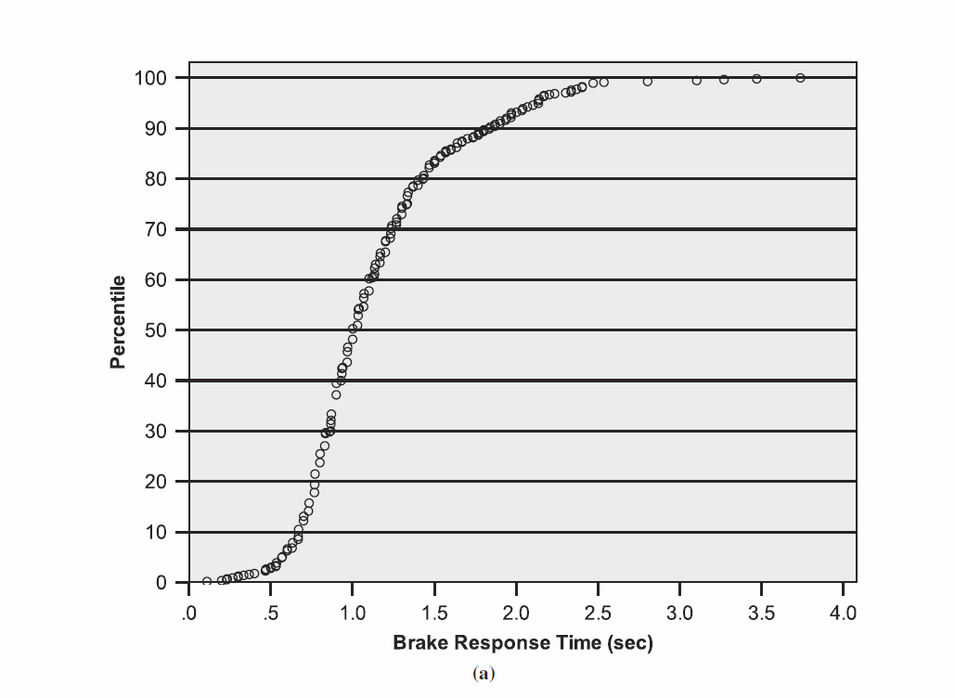
Notes:
This is the ITE yellow change interval equation as it appears in ITE’s Determining Vehicle Change Intervals, 1985. This form as the gG from Parsonson and Santiago.
Note that the equation is an equality. Note the subscript v-naught for velocity. The subscript indicates initial velocity before the vehicle begins decelerating.

Slide 33
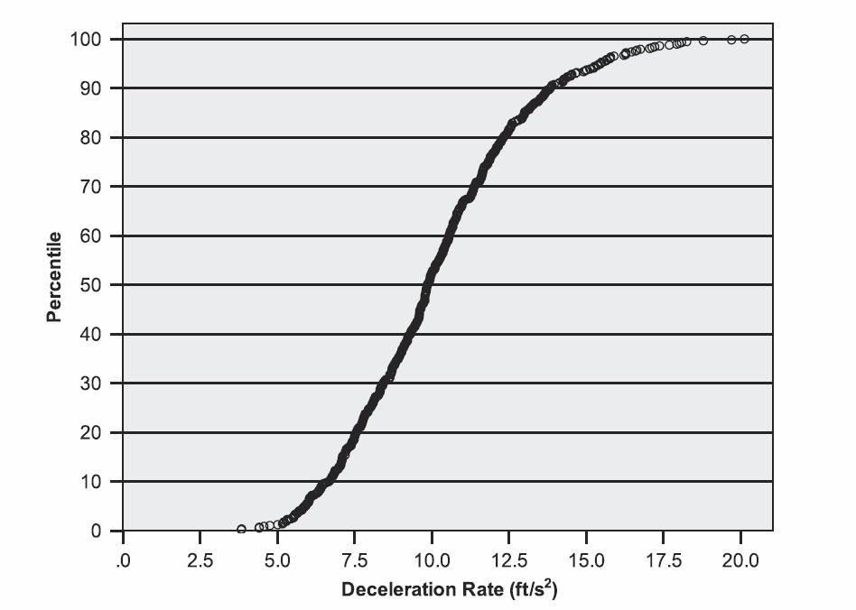

Slide 34
$$Y= t_{p}+ \frac{v}{2(a+gG)}$$
#5. Error. gG – Misapplication of an Analytic Solution
gG was intended to be gravity’s contribution to normal comfortable deceleration.
BUT
gG applies only to emergency stopping. The dynamics are different. gG only applies when the frictional force created between tire and pavement determines the maximum deceleration.
gG can be applied to yellow lights for vehicles going downhill for a different reason: It is not comfortable to press the brakes harder than normal.
gG cannot be applied uphill because drivers press the brake less in order to keep deceleration comfortable. Applying a negative gG shortens the yellow. Drivers actually need more time going uphill because when proceeding into the intersection, gravity slows them down through the critical distance.
Notes:
This is the ITE yellow change interval equation as it appears in ITE’s Determining Vehicle Change Intervals, 1985. This form as the gG from Parsonson and Santiago.
Note that the equation is now an equality.

Slide 35
$$Y= t_{p}+ \frac{v}{2(a+gG)}$$
#6. Omission of Tolerances
Straight Unimpeded Traffic:
$∆Y=\left|\frac{∂Y}{∂t_{p}}∆t_{p}\right|+ \left|\frac{∂Y}{∂a}∆a\right|$ ≈ 2 seconds on a 45 mph road.
Left Turning Traffic:
$∆Y=\left|\frac{∂Y}{∂t_{p}}∆t_{p}\right|+ \left|\frac{∂Y}{∂a}∆a\right|+ \left|\frac{∂Y}{∂v_{i}}∆v_{i}\right|$ =$\left|\frac{2v_{0}}{v_{0}+ v_{i}}∆t_{p}\right|+ \left|\frac{{v_{0}}^{2}}{a^{2}(v_{0}+ v_{i})}∆a\right|+ \left|\left(\frac{2v_{0}\left(t_{p}+ \frac{v_{0}}{2a}\right)}{{\left(v_{0}+ v_{i}\right)}^{2}}\right) ∆v_{i}\right|$ ≈ 3 seconds.
Notes:
This is the ITE yellow change interval equation as it appears in ITE’s Determining Vehicle Change Intervals, 1985. This form as the gG from Parsonson and Santiago.
Note that the equation is an equality. Note the subscript v-naught for velocity. The subscript indicates initial velocity before the vehicle begins decelerating.

Slide 36
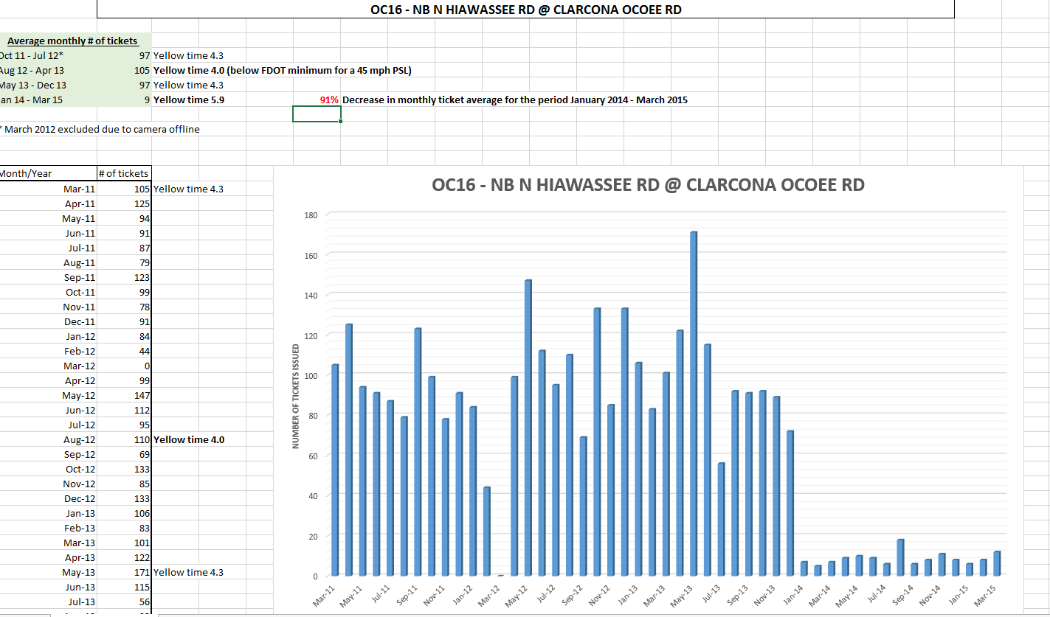
From 4.3 to 5.9 seconds
Notes:
Florida

Slide 37
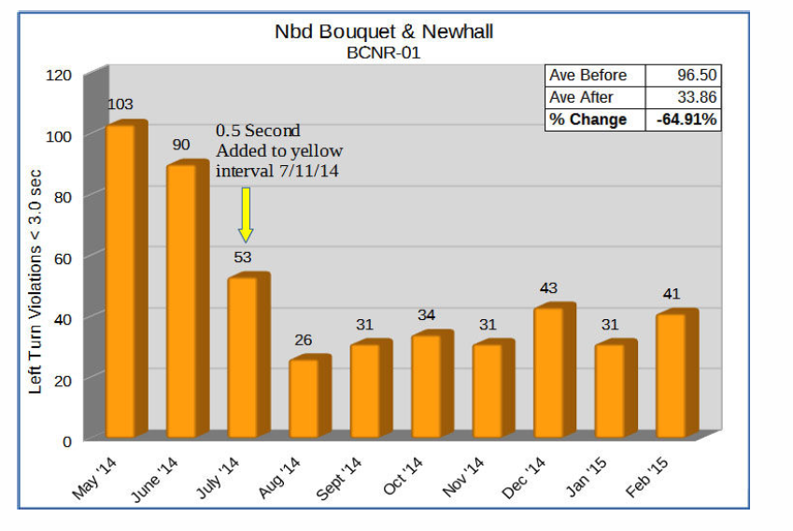
Notes:
Santa Clarita, California

Slide 38
http://talussoftware.com
http://redlightrobber.com
Brian Ceccarelli, P.E., Principal Engineer
Autonomous Vehicles Symposium, Michigan, October 25, 2017

